Slide 1
Customized Repository Search
Bibliographic Indexes
Yoel Kortick

Slide 2
Agenda
  Introduction
  Let's set up two new customized indexes
  Let's check the first new customized index
  Let's check the second new customized index
2

Slide 3
Introduction

Slide 4
Introduction
The “Customized Repository Search Bibliographic Indexes” feature allows institutions to create customized bibliographic search indexes for the Alma staff search.
These customized bibliographic search indexes can be based on any MARC index (see note below regarding field 001-009 and 9XX fields).
For example, the institution can create a customized search index on the MARC 770 field.
This
  Improves the ability of the Alma staff user to retrieve more specific sets of records
  In most cases will eliminate the need to use indication rules to further filter logical sets.
Note: please note that fields 001–009 and all 9XX fields are already customizable and are not included in the new feature. See for example How to define local fields for search and display in Alma and Primo.pptx
FF: MD_CUSTOMIZE_MARC_INDEXES = true
CP: all_field_index = true

Slide 5
Introduction
This will answer the request of many Ideas Exchange requests including:
  Customize Alma Search Indexes
  Add 775 field in the search index
  Need ability to search 79X fields
  Adding the publisher location to the "Keywords" index in Alma
  Allow to define several local search indexes, including standard MARC fields
  Title search - index the 245 field on its own
  Index field 773 $$g for the Alma Repository Search
  Index fields 772 $$w and 830 $$w for the Alma Repository Search
  Index fields 700 $$4 and 710 $$4 for the Alma Repository Search
  Index field 310 for the Alma Repository Search
  MARC field 788 should be searchable
  Index 532 field
  Searchability for MARC 361

Slide 6
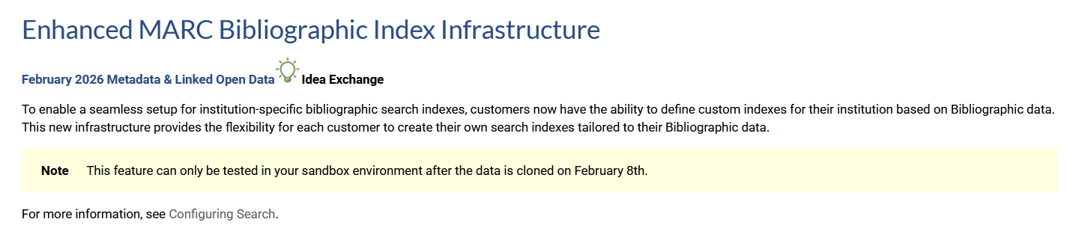
Introduction
From the February 2026 Alma Release Notes

Slide 7
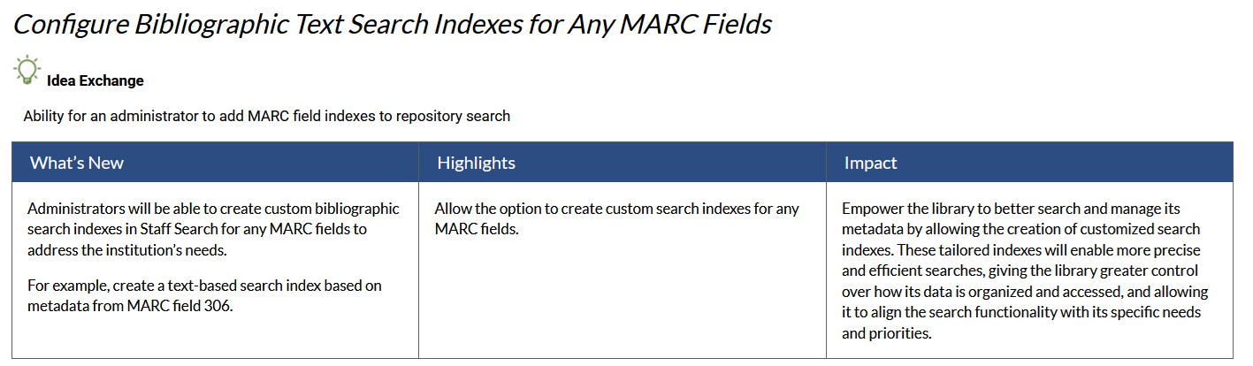
Introduction
From the Alma Roadmap Highlights (2025-2026)

Slide 8
Introduction
The customized repository search bibliographic index will
Include the entire MARC field and not specific subfields
Optionally include a subfield delimiter as part of the customized bibliographic index
  This will allow the Alma staff user to search for text in a specific subfield
  The subfield delimiters will exist as part of the customized bibliographic index if the institution has defined as such
  As explained at Custom Bibliographic Search Indexes:
  A future release will include the option to include the subfield delimiter for Alma searches when using custom Bibliographic search indexes and exclude the subfield delimiters from the data shared with Analytics using the local parameters. This will require a full re-indexing of your institutional data. Contact Ex Libris support to enable this feature.

Slide 9
Let's set up two new customized indexes

Slide 10
Let's set up two new customized indexes
We will now set up two new customized indexes for the following MARC21 Bibliographic fields:
310 Current Publication Frequency
  (this was requested in Ideas Exchange Index field 310 for the Alma Repository Search)
788 Parallel Description in Another Language of Cataloging
  (this was requested in Ideas Exchange MARC field 788 should be searchable)

Slide 11
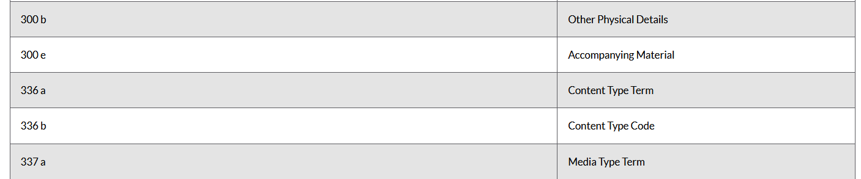
Let's set up two new customized indexes
If we look at MARC 21 Bibliographic All Titles Search, we can see that neither of these fields are by default indexed.
Here we see that there is no 310 field.
310 is not indexed. If it were indexed, then it would appear here in the table

Slide 12
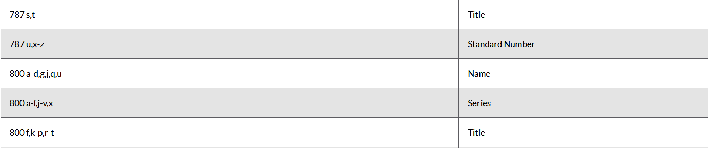
Let's set up two new customized indexes
If we look at MARC 21 Bibliographic All Titles Search, we can see that neither of these fields are by default indexed.
Here we see that there is no 788 field.
788 is not indexed. If it were indexed, then it would appear here in the table

Slide 13
Let's set up two new customized indexes
First, we will add each of these indexes.
Then we will give each of the new indexes a logical name.

Slide 14
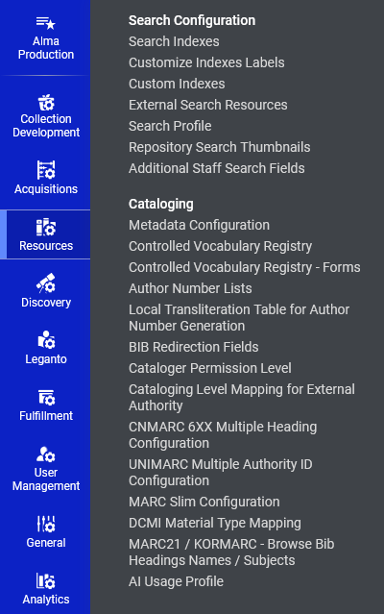
Let's set up two new customized indexes
Access “Configuration > Resources > Search Configuration > Custom Indexes”

Slide 15
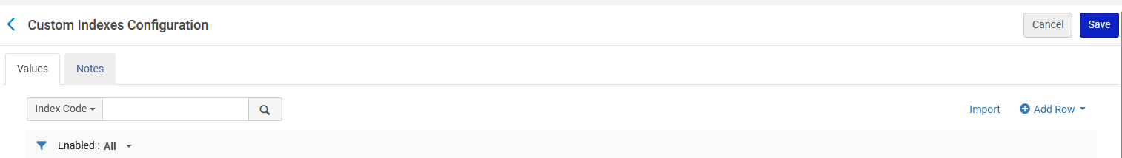
Let's set up two new customized indexes
On the “Custom Indexes Configuration page click “Add Row”

Slide 16
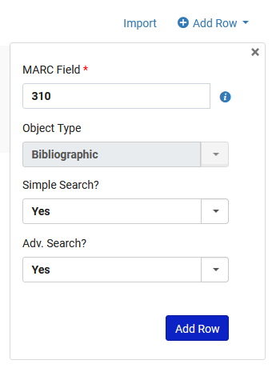
Let's set up two new customized indexes
We add the 310 field to be indexed for Simple Search and Advanced Search.

Slide 17
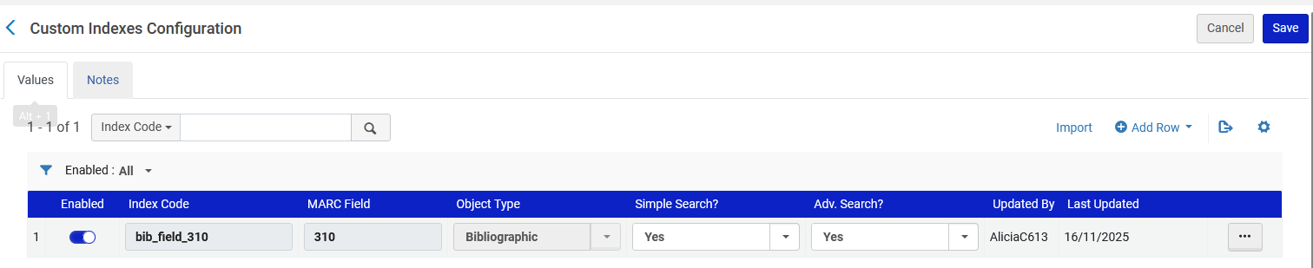
Let's set up two new customized indexes
The field is added and gets Index Code “bib_field_310”

Slide 18
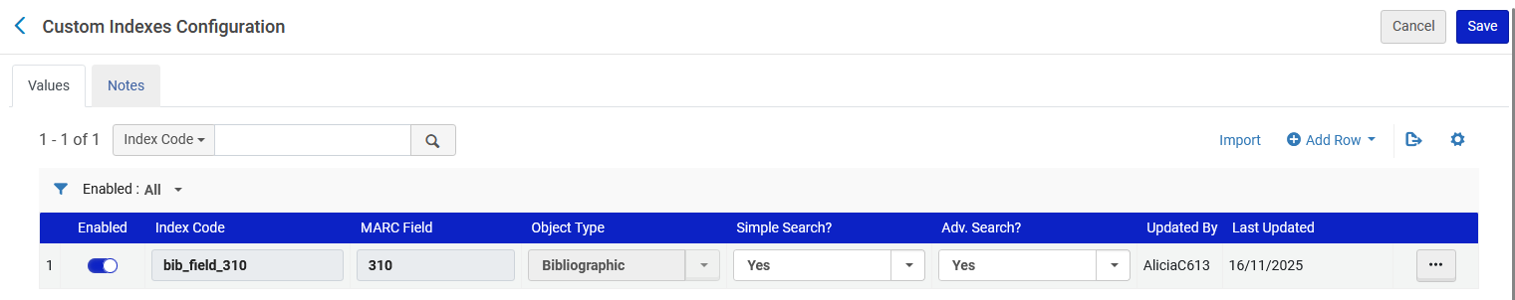
Let's set up two new customized indexes
Again, on the “Custom Indexes Configuration page click “Add Row”

Slide 19
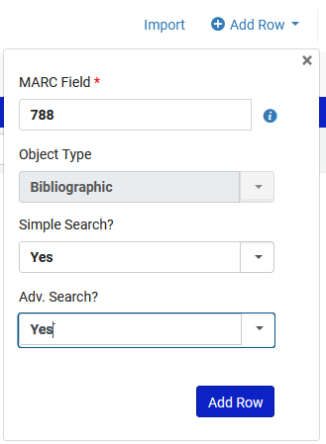
Let's set up two new customized indexes
We add the 788 field to be index for Simple Search and Advanced Search.

Slide 20
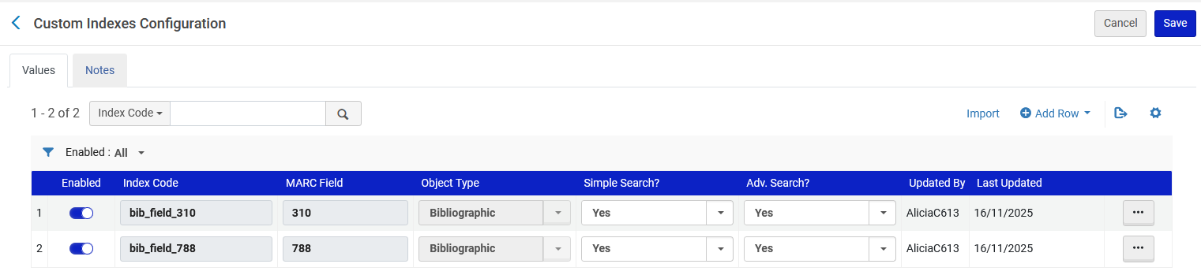
Let's set up two new customized indexes
The field is added and gets Index Code “bib_field_788”

Slide 21
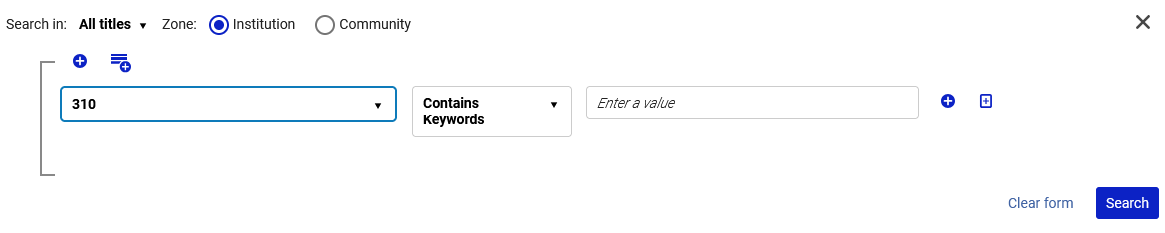
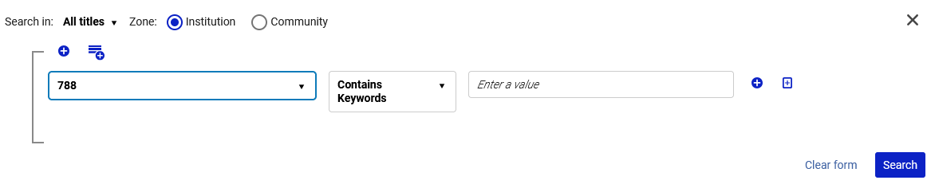
Let's set up two new customized indexes
Now we will give each of these new indexes (“bib_field_310” and “bib_field_788”) a logical name. Currently they appear as follows in the repository search.

Slide 22
Let's set up two new customized indexes
Access “Configuration > Resources > Search Configuration > Customize Indexes Labels”

Slide 23
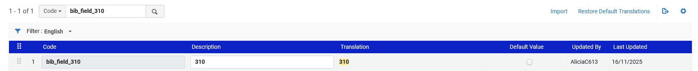
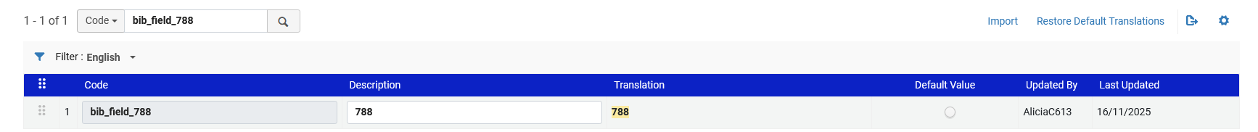
Let's set up two new customized indexes
We will change these …

Slide 24
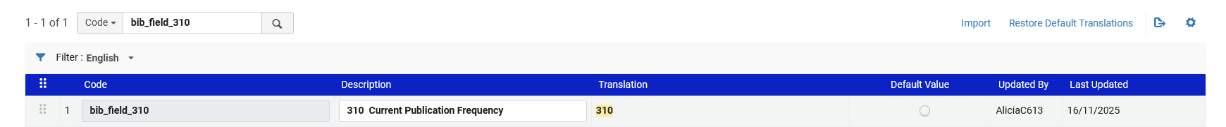
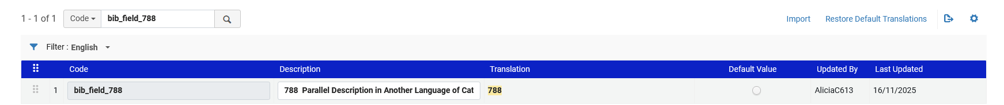
Let's set up two new customized indexes
To these …

Slide 25
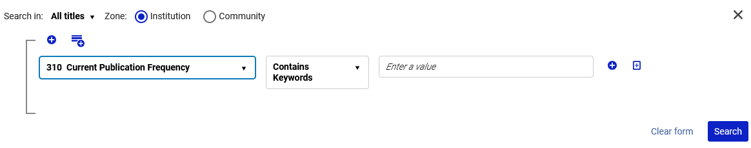
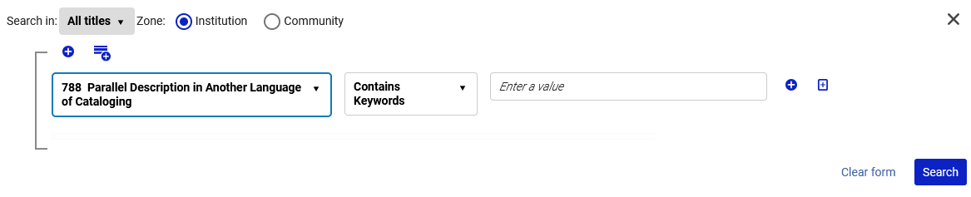
Let's set up two new customized indexes
Now we have the new text when searching via the new index

Slide 26
Let's set up two new customized indexes
Here are the new indexes in the Simple Search

Slide 27
Let's check the first new customized index

Slide 28
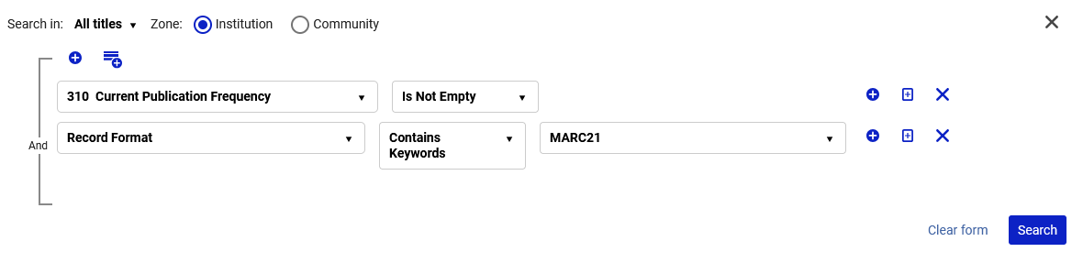
Let's check the first new customized index
Let’s begin with a search of all records which have a 310 field.
This particular institution has bibliographic records in multiple formats, and we want now only records in format MARC21. Hence the additional search by “Record Format” in this particular case.
“Is Not Empty” means that the field must exist

Slide 29
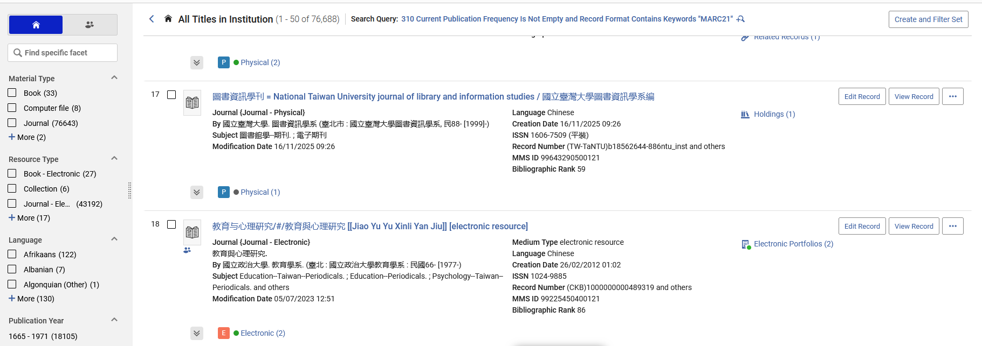
Let's check the first new customized index
We will randomly check one of the results and see if there really is a 310 field.
We will check title “圖書資訊學刊 = National Taiwan University journal of library and information studies / 國立臺灣大學圖書資訊學系編”

Slide 30
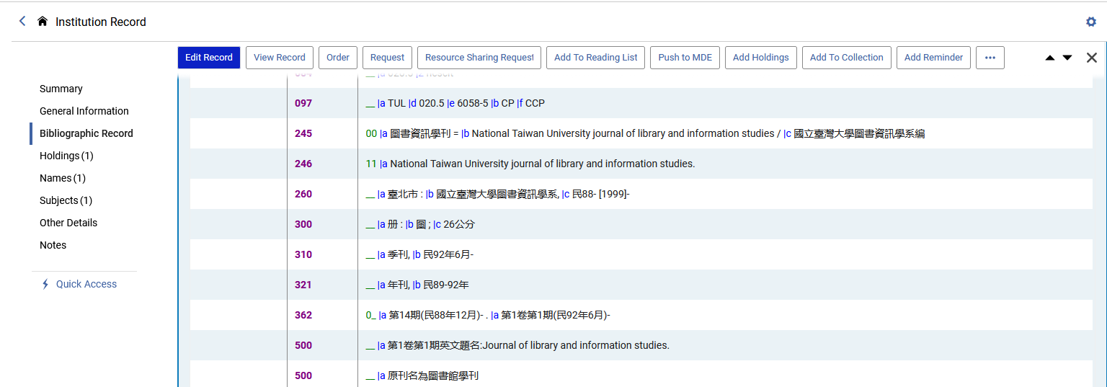
Let's check the first new customized index
As expected, title “圖書資訊學刊 = National Taiwan University journal of library and information studies / 國立臺灣大學圖書資訊學系編” does have a 310 field

Slide 31
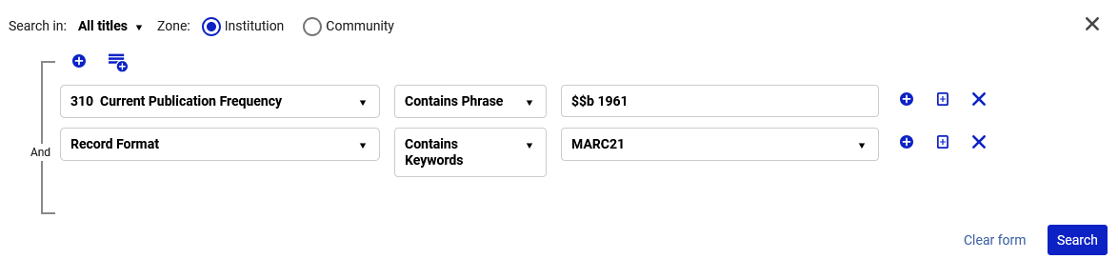
Let's check the first new customized index
We will now search for all records which have a 310 subfield b which begins with “1961”.
This institution does have subfield delimiters which exist as part of the customized bibliographic index (as explained in the introduction)
Because we are stating that there needs to be a “Contains Phrase” with “$$b 1961” we are essentially stating that the subfield b needs to begin with “1961”.
We are using the subfield delimiter in the search

Slide 32
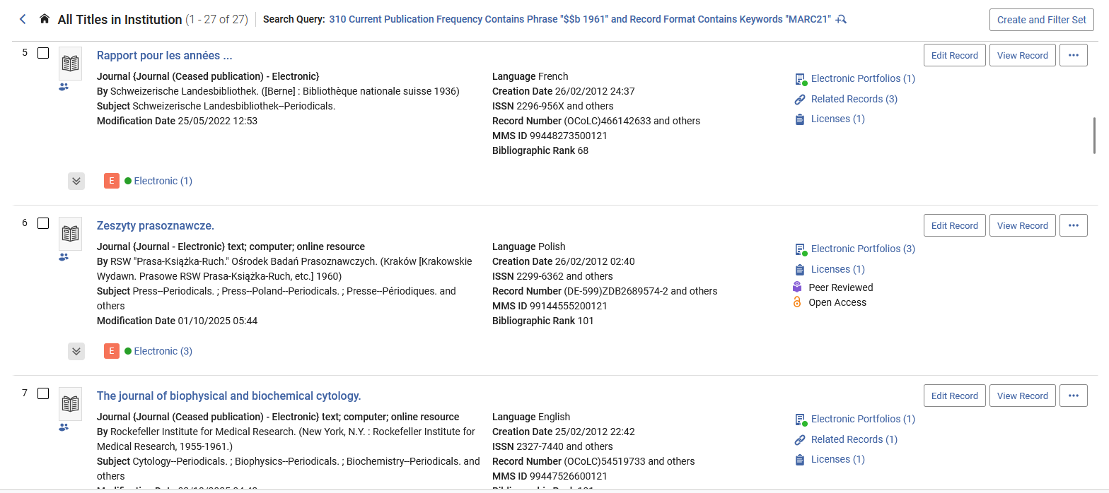
Let's check the first new customized index
All of these results should have a 310 subfield b which begins with “1961”
We will randomly check these three records:
Rapport pour les années ...
Zeszyty prasoznawcze.
The journal of biophysical and biochemical cytology.

Slide 33
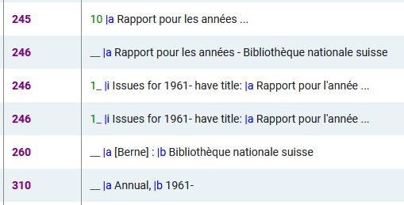
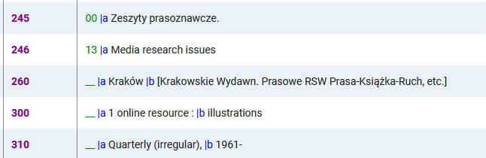
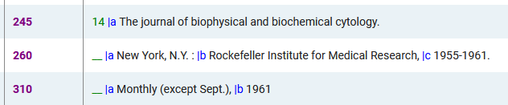
Let's check the first new customized index
As expected, all results do have a 310 subfield b which begins with 1961

Slide 34
Let's check the first new customized index
This search which we just did could replace an indication rule which states “retrieve all records which have a 310 subfield b which begins with “1961”.

Slide 35
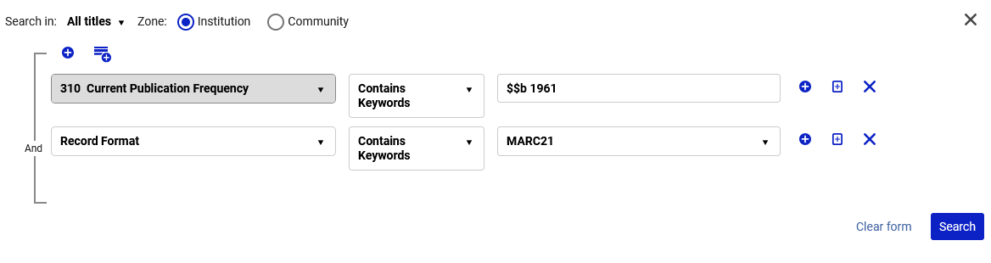
Let's check the first new customized index
We will now search for all records which have a 310 subfield b which contains text “1961” anywhere in the subfield.
This institution does have subfield delimiters will exist as part of the customized bibliographic index (as explained in the introduction)
Because we are stating “Contains Keywords” and not “Contains Phrase” with “$$b 1961” we are essentially stating that the “1961” can be anywhere in the subfield.
We are using the subfield delimiter in the search

Slide 36
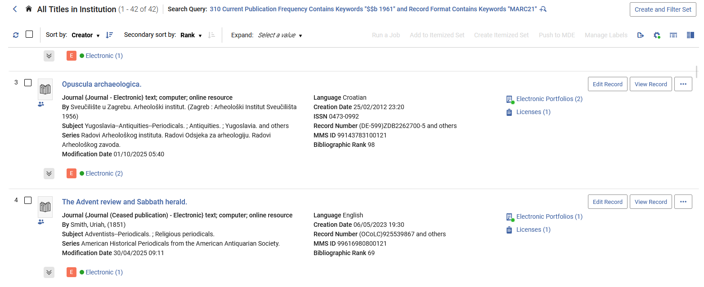
Let's check the first new customized index
All of these results should have a 310 with text “1961” anywhere in subfield b
Let’s check for example “The Advent review and Sabbath herald

Slide 37
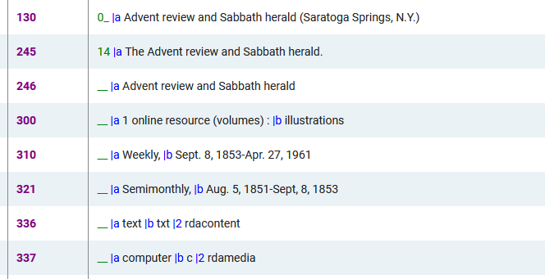
Let's check the first new customized index
As expected, the 310 subfield b does contain text “1961” and it does not need to be at the beginning of the subfield b. It can be anywhere in the subfield b.

Slide 38
Let's check the first new customized index
This search which we just did could replace an indication rule which states “retrieve all records which have a 310 subfield b which contains text “1961” anywhere in the subfield”.

Slide 39
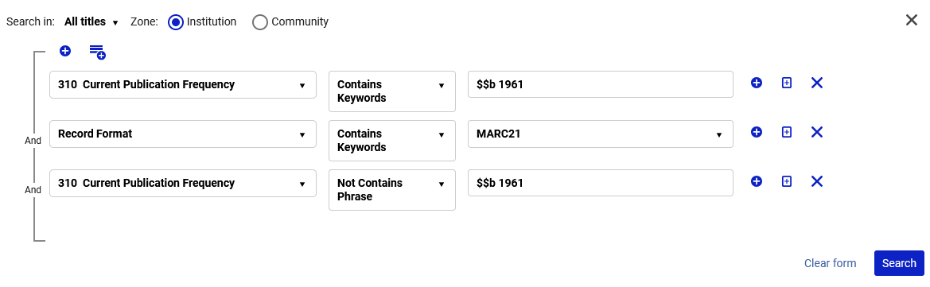
Let's check the first new customized index
Here we are stating “Retrieve all records which have text “1961” in the 310 subfield b and the “1961” is not at the beginning of the field.
It will give us all records which have text “1961” anywhere in subfield b because of the “Contains Keywords” “$$b 1961” search.
It will not give any records which have text “1961” at the beginning of subfield b because of the “Not Contains Phrase” “$$b 1961” search.

Slide 40
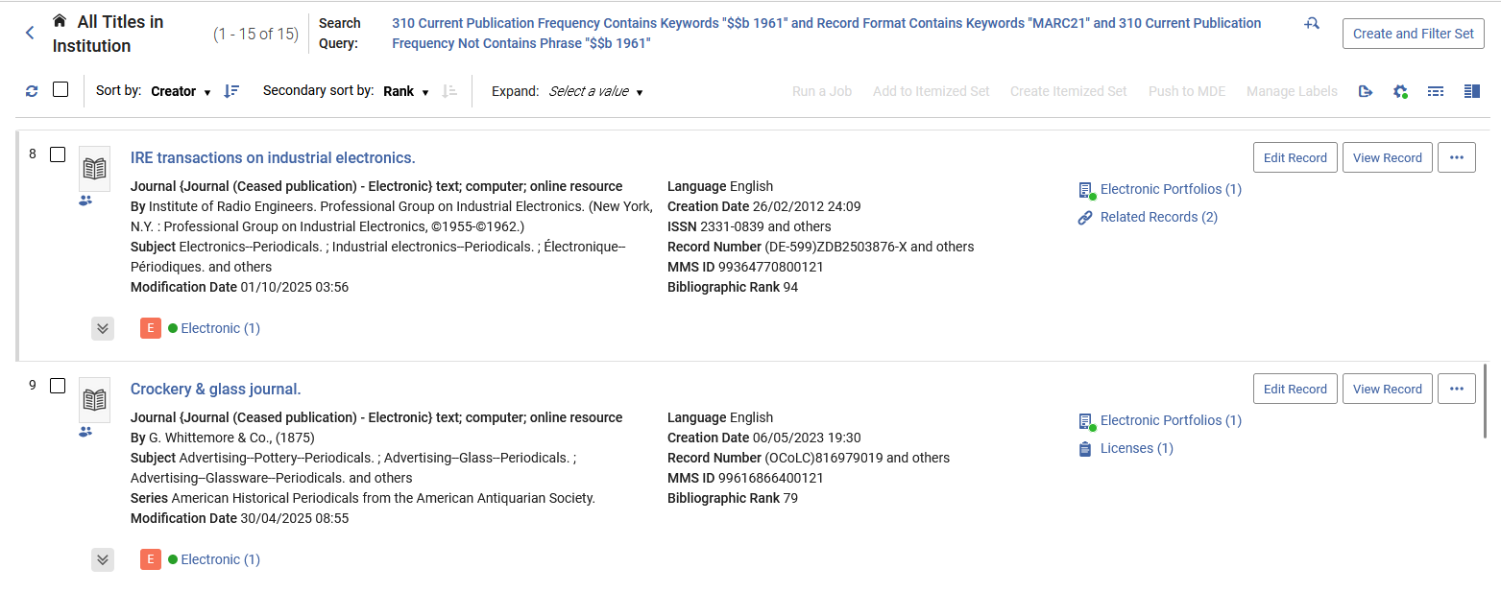
Let's check the first new customized index
These records should all have text “1961” somewhere in subfield b of the 310 field but not at the beginning of the subfield.
Let’s check for example “Crockery & glass journal”

Slide 41
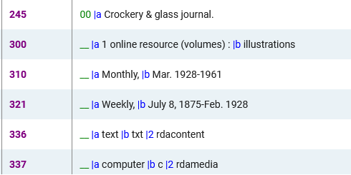
Let's check the first new customized index
The records does correctly have text “1961” somewhere in subfield b of the 310 field but not at the beginning of the subfield.

Slide 42
Let's check the first new customized index
This search which we just did could replace an indication rule which states “retrieve all records which have text “1961” anywhere in 310 subfield b except for in the beginning of the subfield.

Slide 43
Let's check the second new customized index

Slide 44
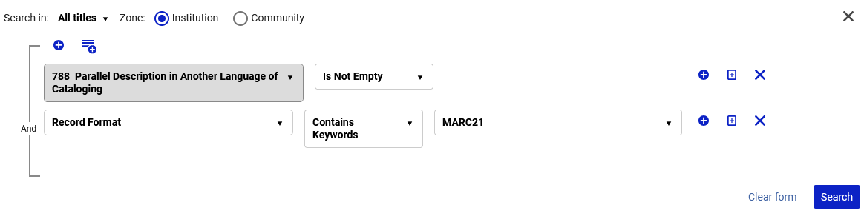
Let's check the second new customized index
Let’s begin with a search of all records which have a 788 field.
This particular institution has bibliographic records in multiple formats, and we want now only records in format MARC21. Hence the additional search by “Record Format” in this particular case.
“Is Not Empty” means that the field must exist

Slide 45
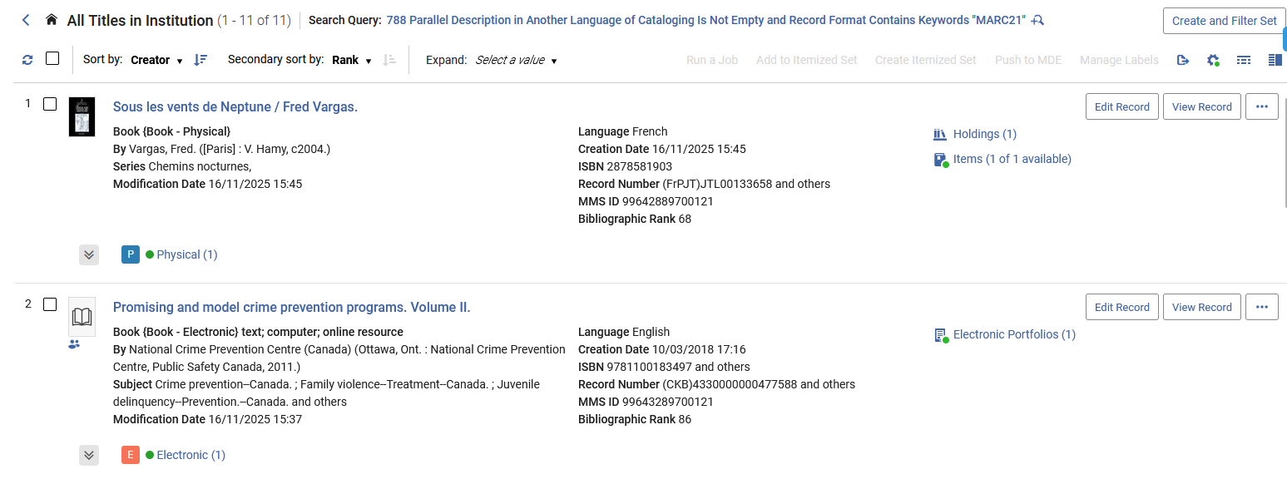
Let's check the second new customized index
We will randomly check one of the results and see if there really is a 788 field.
We will check title “Sous les vents de Neptune / Fred Vargas”

Slide 46
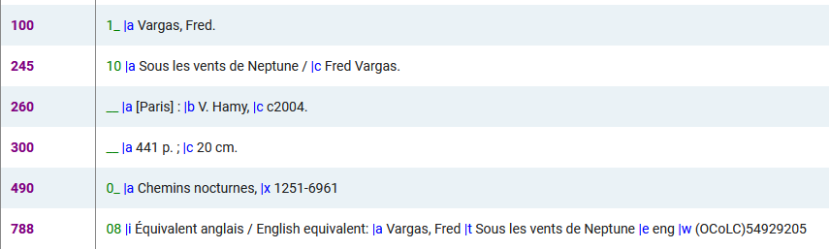
Let's check the second new customized index
As expected, title “Sous les vents de Neptune / Fred Vargas” does have a 788 field

Slide 47
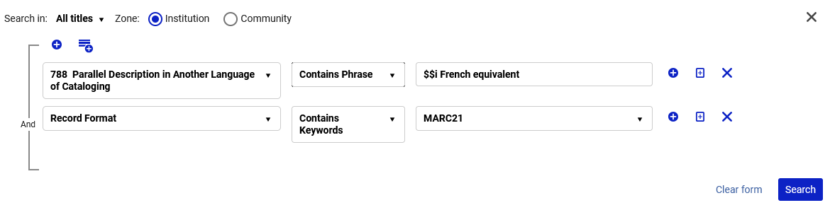
Let's check the second new customized index
We will now search for all records which have a 788 subfield i which begins with “French equivalent”.
This institution does have subfield delimiters which exist as part of the customized bibliographic index (as explained in the introduction)
Because we are stating that there needs to be a “Contains Phrase” with “$$i French equivalent” we are essentially stating that the subfield i needs to begin with “French equivalent”.
We are using the subfield delimiter in the search

Slide 48
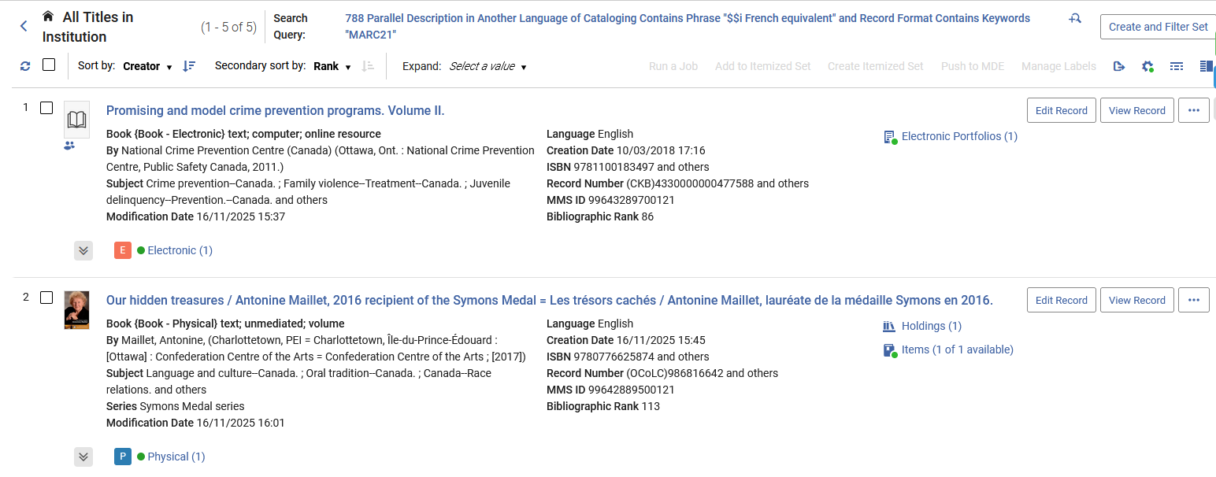
Let's check the second new customized index
All of these results should have a 788 subfield i which begins with “French equivalent”
We will randomly check these two records:
Promising and model crime prevention …
Our hidden treasures

Slide 49
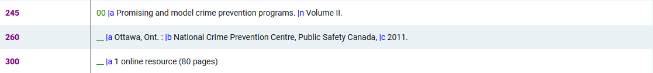
Let's check the second new customized index
As expected, all results do have a 788 subfield i which begins with “French equivalent”

Slide 50
Let's check the second new customized index
This search which we just did could replace an indication rule which states “retrieve all records which have a 788 subfield i which begins with “French equivalent”.

Slide 51
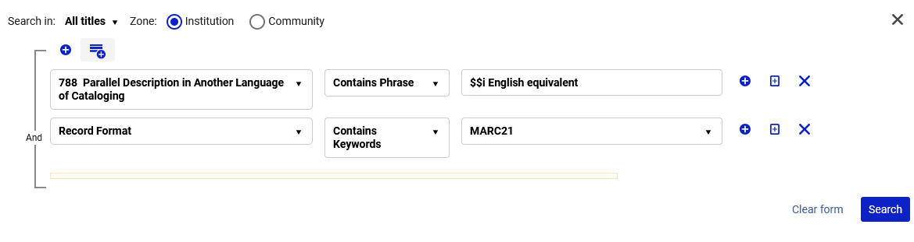
Let's check the second new customized index
Note that if we search for all records which have a 788 subfield i that begins with “English equivalent” we get no results.
Below we search for “788 Parallel Description in Another Language of Cataloging” “Contains Phrase” “$$i English equivalent”
We are using the subfield delimiter in the search

Slide 52
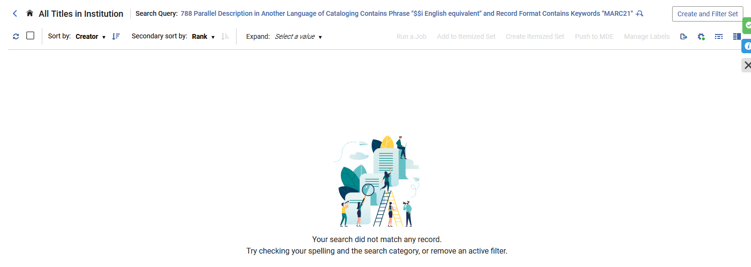
Let's check the second new customized index
The reason that we get no results is because there are no records with a 788 subfield i that starts with “English equivalent”.

Slide 53
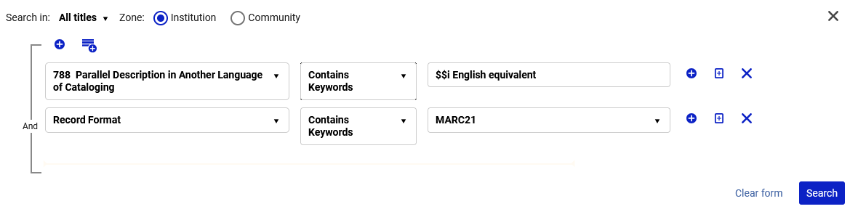
Let's check the second new customized index
Now, however, instead of “Contains phrase”, we will use “Contains Keywords”.
This means that the “$$i” and the “English Equivalent” do not have to be together as a phrase but rather both need to appear in the 788 field as keywords.
Contains Keywords

Slide 54
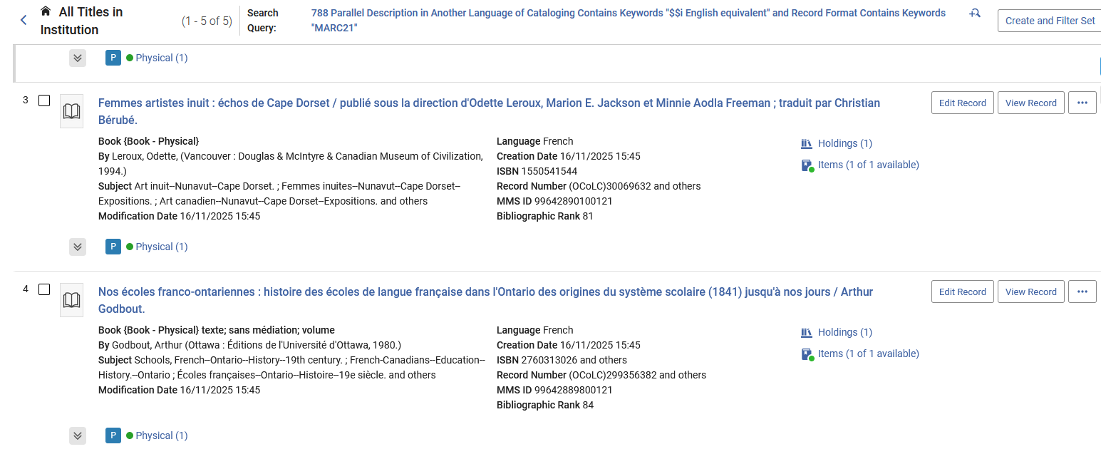
Let's check the second new customized index
Now we do have results
We will randomly check these two records:
Femmes artistes inuit : échos de Cape Dorset
Nos écoles franco-ontariennes : histoire des …

Slide 55
Let's check the second new customized index
As expected, the 788 subfield i does contain text “English equivalent” and it does not need to be at the beginning of the subfield i. It can be anywhere in the subfield i.

Slide 56
Let's check the second new customized index
This search which we just did could replace an indication rule which states “retrieve all records which have a 788 subfield i which contains text “English equivalent” anywhere in the subfield”.

Slide 57
Thank You

